Slide 1
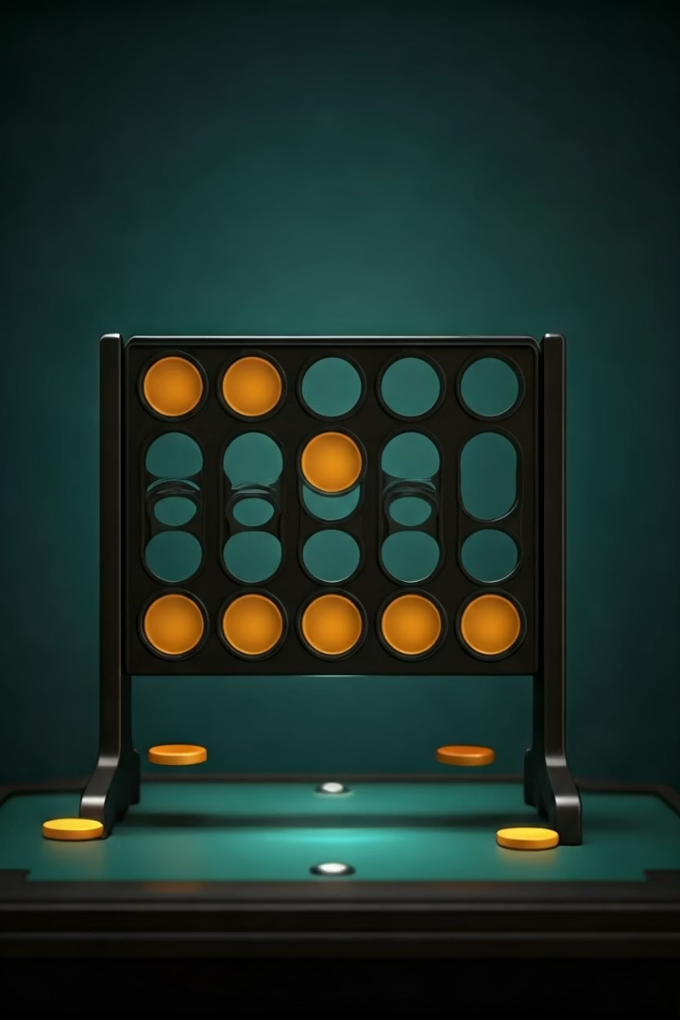
Connect 4 AI Evaluation: Minimax vs Monte Carlo Tree Search
Presented by Team Matrix:
GitHub Repository: https://github.com/Greeshma-DS/Team-Matrix.git
TEAM MEMBERS : Greeshma ,Kiranmayi ,Pravalika

Slide 2
Introduction
This project implements and compares two artificial intelligence (AI) strategies for the game Connect 4 :
Minmax with Alpha-Beta Pruning and Monte Carlo Tree Search (MCTS)
The project uses a Streamlit-based web interface to simulate multiple games between the two algorithms, allowing users
to adjust parameters such as the depth of the Minimax algorithm and the number of simulations for MCTS.
The performance of the algorithms is analyzed using metrics such as win rate, decision time, and strategic decision-making .
Preliminary results indicate that MCTS outperforms MINMAX in both win rate and decision time, although MCTS shows
potential for improvement with further optimization .
This comparison provides valuable insights into deterministic versus probabilistic AI approaches in zero-sum
games and offers practical applications in the fields of game theory and AI education.
.

Slide 3
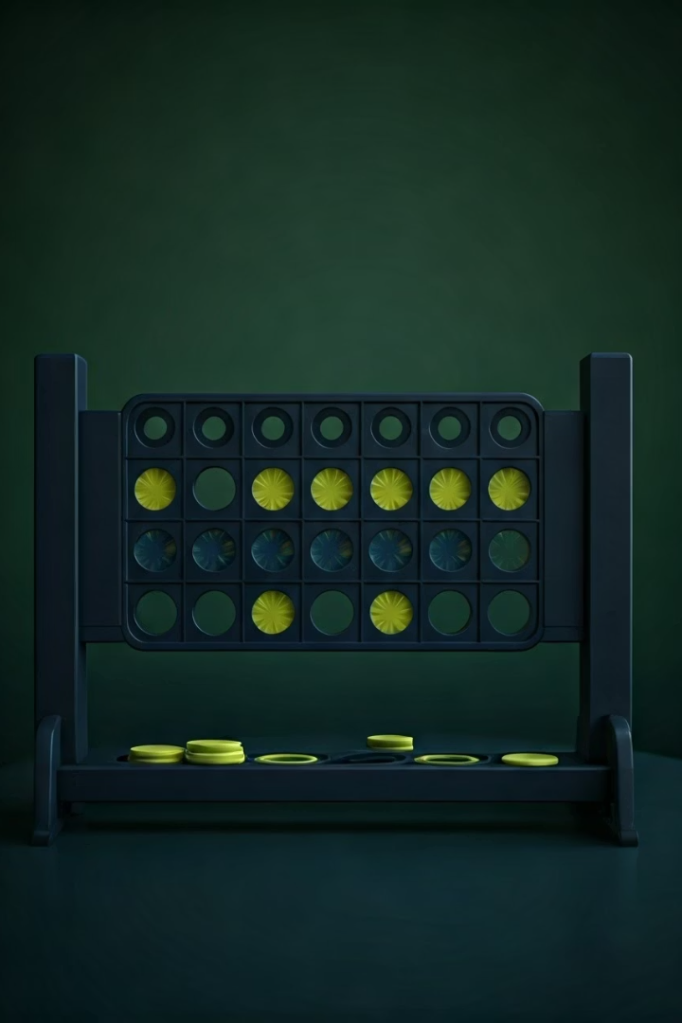
Background and Research Question
Research Question
Game Overview
Which AI algorithm Minimax with Alpha-Beta Pruning or Monte Carlo Tree Search (MCTS) performs better in Connect 4 regarding win rate, decision time, and strategic decision-making?
Connect 4 is a two-player zero-sum game where players drop discs into a 6x7 grid aiming to connect four in a row horizontally, vertically, or diagonally.
AI Strategies
Minimax is a deterministic tree search with pruning, while MCTS uses probabilistic simulations to estimate move quality.

Slide 4
Methodology: Game and AI Implementation
Game Setup
Board Setup : The Connect 4 board is a 6x7 grid, which is represented as a NumPy array for efficient processing.
Game Mechanics : Players take turns dropping discs into the columns of the grid, with the goal of connecting four discs in a row either horizontally, vertically, or diagonally. The game automatically checks for wins or draws after each move.
Utility Functions : A set of utility functions is implemented to handle tasks such as creating the board, validating moves, placing pieces, and detecting wins or draws.
Algorithms Used :
Minimax with Alpha-Beta Pruning: A deterministic tree search algorithm that explores all possible moves up to a specified depth and uses pruning to eliminate branches of the game tree that do not lead to optimal solutions. In this project Minimax explores moves up to adjustable depth with Alpha-Beta Pruning, prioritizing center control and blocking threats.
Monte Carlo Tree Search (MCTS): A probabilistic AI algorithm that uses random simulations to estimate the quality of each possible move and select the best move based on these estimates. MCTS runs random simulations (default 50) using UCT to balance exploration and exploitation.

Slide 5

What Makes our project unique ?
We built more than just a Connect 4 game we developed an AI
benchmarking platform.
Compared two intelligent agents (Minimax vs. MCTS) through:
Multiple simulations
Performance tracking (win rate, move time)
Strategic evaluation
Integrated Streamlit for interactive analysis and Pygame for live gameplay animation.
Provided both visual and analytical evaluation to draw meaningful insights.
Designed to be both technically insightful and engaging for users.

Slide 6
Tools ,Technologies and System Requirements
Technologies Used:
Python(v3.7+): Core language for AI logic and simulation.
Libraries:
• NumPy – Board representation and matrix ops
• Streamlit – Interactive web app interface
• Matplotlib – Performance visualization
• random , time, math – Support for simulations, timing ,and Minimax logic
System Requirements:
OS: Windows / macOS / Linux
RAM: 4 GB minimum (8 GB recommended)
CPU: Dual-core or better
Setup: pip install NumPy Streamlit matplotlib
.

Slide 7
Building Blocks of Connect 4 AI Simulation :
Board Management: create_board(), drop_piece(), is_valid_location(), get_next_open_row(), get_valid_locations()
Win Detection: winning_move()
Minimax AI: minimax()
MCTS AI: mcts_move(), simulate_game()
Visualization: display_board()
Streamlit Simulation & Interface: Simulation Loop, Interface
Minimax and MCTS Logic :
Based on standard Python AI tutorials from GeeksForGeeks, Towards Data Science, and GitHub examples.
Streamlit Integration :
Official Streamlit Docs used for UI, sliders, and live output features
Code Debugging and Structure :
Self- developed logic with support from stack Overflow and NumPy documentation

Slide 8

Project Demo Overview
Watch how AI algorithms play Connect 4 in real time. See strategies unfold with Minimax and MCTS competing.
The demo illustrates decision-making speed, move quality, and gameplay visualization using our interface tools.

Slide 9



Performance Evaluation and Metrics
Decision Time
MCTS averages 0.27 seconds per move; Minmax averages 3.34 seconds after optimization.
Win Rate
Strategic Quality
MCTS initially outperformed Minmax, but tuning improved MCTS to win more games.
MCTS uses heuristics; Minmax relies on simulation quality and UCT tuning for strategic decisions.
2
1
3

Slide 10

Challenges and Achievements
MCTS Performance
Minimax Optimization
Reduced simulations to 50 to cut move time; further optimizations planned.
Implemented Alpha-Beta Pruning for 60% branch pruning, improving speed and strategy.
GUI Development
Win Rate Improvement
Overcame initial unfamiliarity with Pygame to build a functional animated game interface.
Tuned MCTS parameters to increase win rate from 10% to 100% in preliminary tests.

Slide 11
Next Steps and Conclusion
Enhance GUI
Add difficulty sliders and board size options for user customization.
Expand Testing
Run large-scale simulations (100+ games) for robust statistical analysis.
Human Interaction
Enable human vs AI mode in Streamlit and finalize project deliverables.
This project successfully compared Minimax and MCTS in Connect 4, showing Minimax's speed advantage and MCTS's strategic potential.

